Slide 1
Project Name: Customer Analytics using SQL

Slide 2
Project overview
Objective: To perform detailed analysis on customer data (projects.ctb table)
by using SQL queries, uncovering patterns related to income, spending behavior,
membership status, subscription types, and customer satisfaction.
Tools Used:
SQL (Structured Query Language)

Slide 3
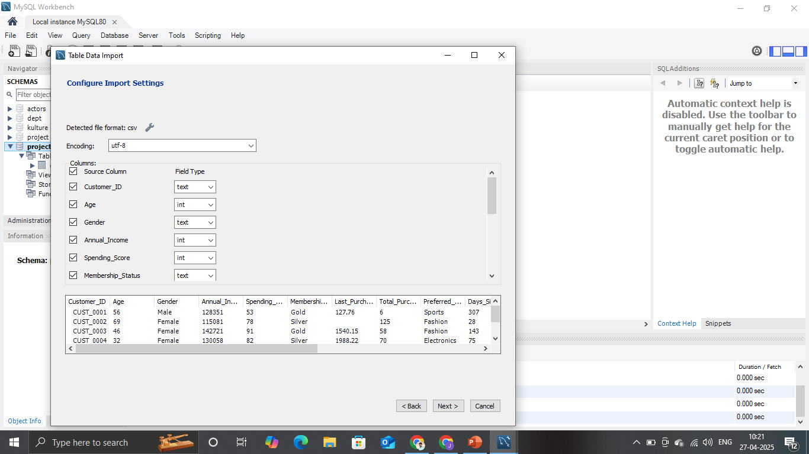
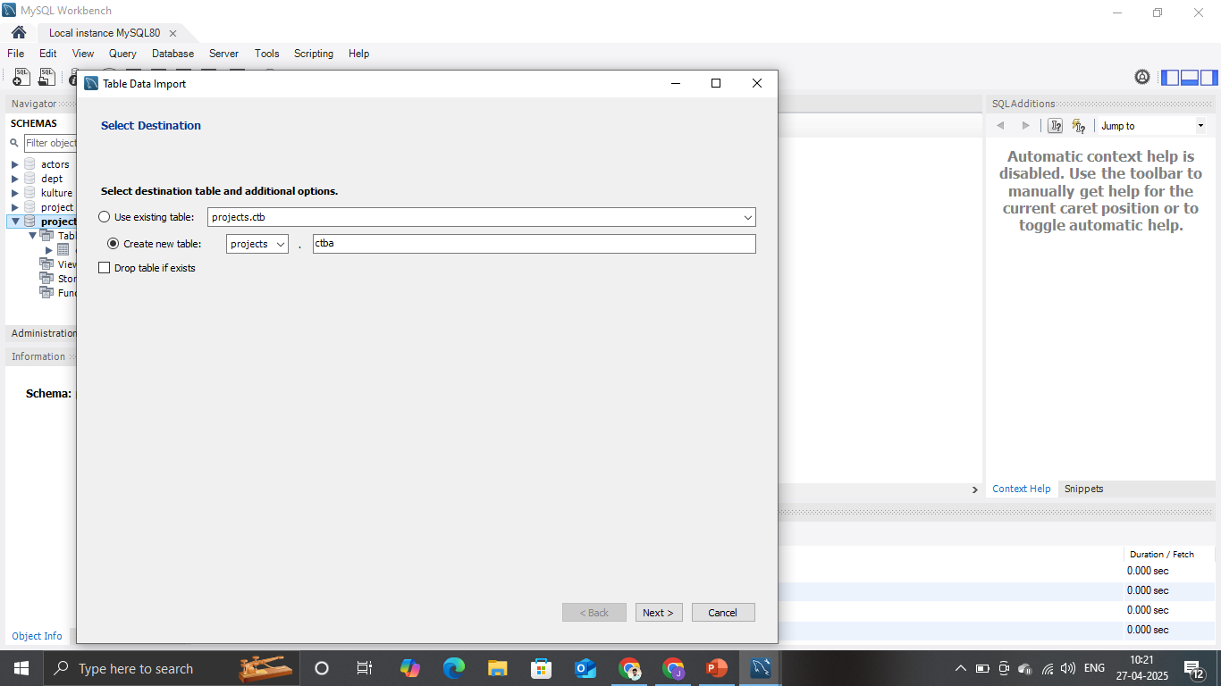
Data source import
Data Source: Kangle
File Type: CSV
Rows: 10000

Slide 4
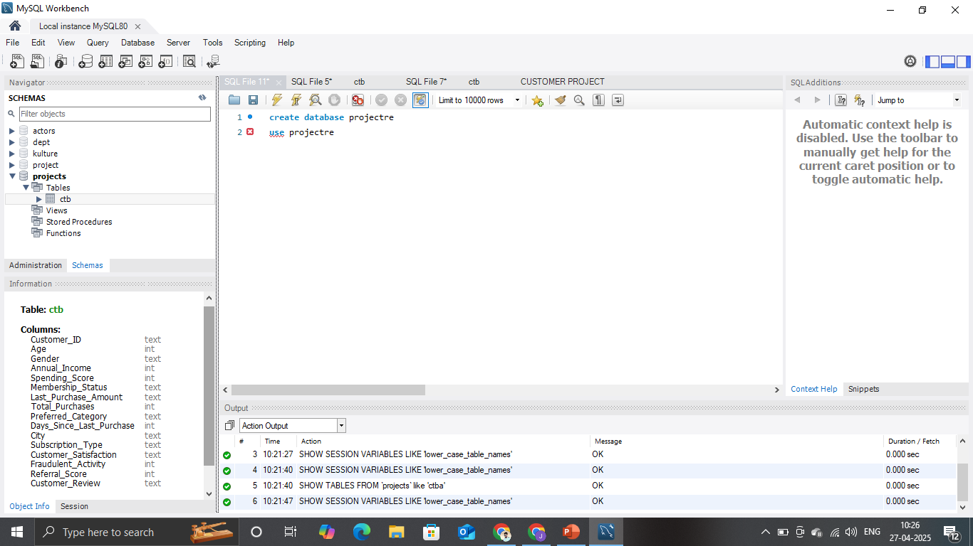
Table schema & type optimization

Slide 5
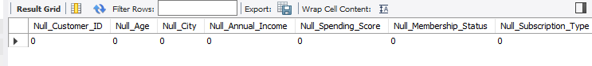
Missing values
SELECT
SUM(CASE WHEN Customer_ID IS NULL THEN 1 ELSE 0 END) AS Null_Customer_ID,
SUM(CASE WHEN Age IS NULL THEN 1 ELSE 0 END) AS Null_Age,
SUM(CASE WHEN City IS NULL THEN 1 ELSE 0 END) AS Null_City,
SUM(CASE WHEN Annual_Income IS NULL THEN 1 ELSE 0 END) AS Null_Annual_Income,
SUM(CASE WHEN Spending_Score IS NULL THEN 1 ELSE 0 END) AS Null_Spending_Score,
SUM(CASE WHEN Membership_Status IS NULL THEN 1 ELSE 0 END) AS Null_Membership_Status,
SUM(CASE WHEN Subscription_Type IS NULL THEN 1 ELSE 0 END) AS Null_Subscription_Type,
SUM(CASE WHEN Preferred_Category IS NULL THEN 1 ELSE 0 END) AS Null_Preferred_Category,
SUM(CASE WHEN Total_Purchases IS NULL THEN 1 ELSE 0 END) AS Null_Total_Purchases,
SUM(CASE WHEN Customer_Satisfaction IS NULL THEN 1 ELSE 0 END) AS Null_Customer_Satisfaction,
SUM(CASE WHEN Last_Purchase_Amount IS NULL THEN 1 ELSE 0 END) AS Null_Last_Purchase_Amount,
SUM(CASE WHEN Days_Since_Last_Purchase IS NULL THEN 1 ELSE 0 END) AS Null_Days_Since_Last_Purchase,
SUM(CASE WHEN Referral_Score IS NULL THEN 1 ELSE 0 END) AS Null_Referral_Score
FROM ctb;

Slide 6
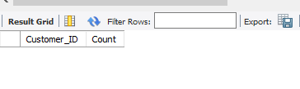
Duplicate values
SELECT Customer_ID, COUNT(*) AS CountFROM ctbGROUP BY Customer_IDHAVING COUNT(*) > 1;

Slide 7
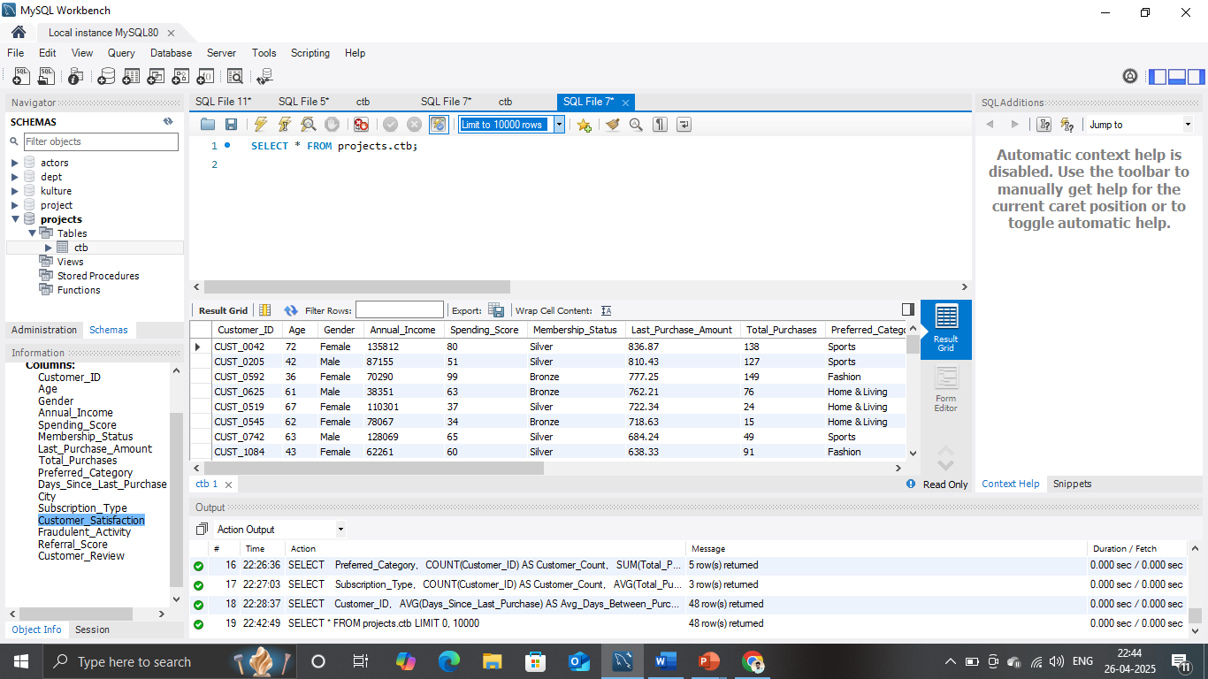
Table Overview
Query/Task: View all data from the projects.ctb table.
SQL Answer:
sql
SELECT * FROM projects.ctb;

Slide 8
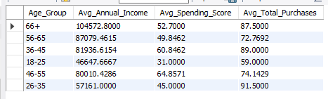
Customer Analysis by Age Group
Query/Task: Group customers into age ranges and calculate average Annual Income, Spending Score, and Total Purchases.
SQL Answer:
WITH agerange AS (
SELECT CASE WHEN Age BETWEEN 18 AND 25 THEN '18-25’
WHEN Age BETWEEN 26 AND 35 THEN '26-35’
WHEN Age BETWEEN 36 AND 45 THEN '36-45’
WHEN Age BETWEEN 46 AND 55 THEN '46-55’
WHEN Age BETWEEN 56 AND 65 THEN '56-65' ELSE '66+’
END AS Age_Group, Annual_Income, Spending_Score, Total_Purchases
FROM ctb ) SELECT Age_Group, AVG(Annual_Income) AS Avg_Annual_Income,
AVG(Spending_Score) AS Avg_Spending_Score, AVG(Total_Purchases) AS Avg_Total_Purchases
FROM agerange GROUP BY Age_Group;

Slide 9
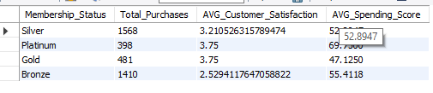
Analysis by Membership Status
Query/Task: Calculate total purchases and average satisfaction and spending score grouped by membership status.
SQL Answer:
SELECT Membership_Status, SUM(Total_Purchases) AS Total_Purchases,
AVG(Customer_Satisfaction) AS AVG_Customer_Satisfaction,
AVG(Spending_Score) AS AVG_Spending_Score FROM CTB GROUP BY Membership_Status;

Slide 10
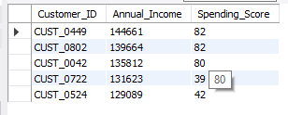
Top 5 High Income and High Spending Customers
Query/Task: Find the top 5 customers with the highest annual income and spending score.
SQL Answer:
sql
SELECT Customer_ID, Annual_Income, Spending_Score
FROM CTB ORDER BY Annual_Income DESC, Spending_Score DESC LIMIT 5;

Slide 11
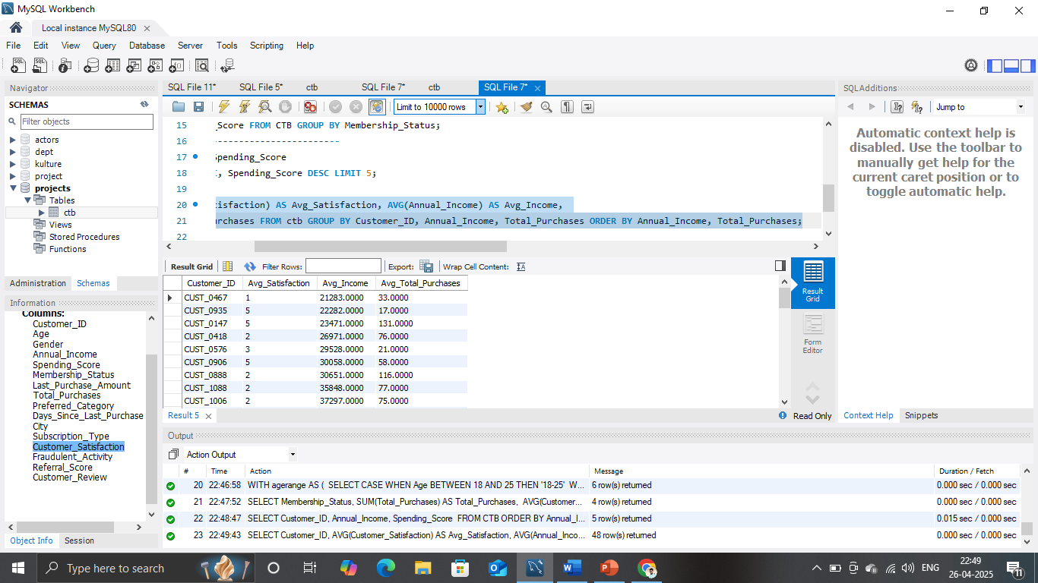
Customer-Wise Averages
Query/Task: Find average satisfaction, income, and total purchases for each customer.
SQL Answer:
SELECT Customer_ID, AVG(Customer_Satisfaction) AS Avg_Satisfaction,
AVG(Annual_Income) AS Avg_Income,
AVG(Total_Purchases) AS Avg_Total_Purchases
FROM ctb GROUP BY Customer_ID, Annual_Income, Total_Purchases
ORDER BY Annual_Income, Total_Purchases;

Slide 12
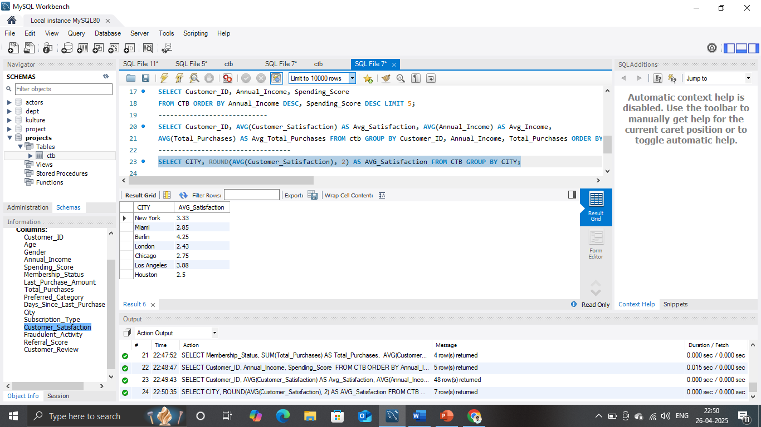
Average Satisfaction by City
Query/Task: Find average customer satisfaction per city.
SQL Answer:
SELECT CITY, ROUND(AVG(Customer_Satisfaction), 2) AS AVG_Satisfaction
FROM CTB GROUP BY CITY;

Slide 13
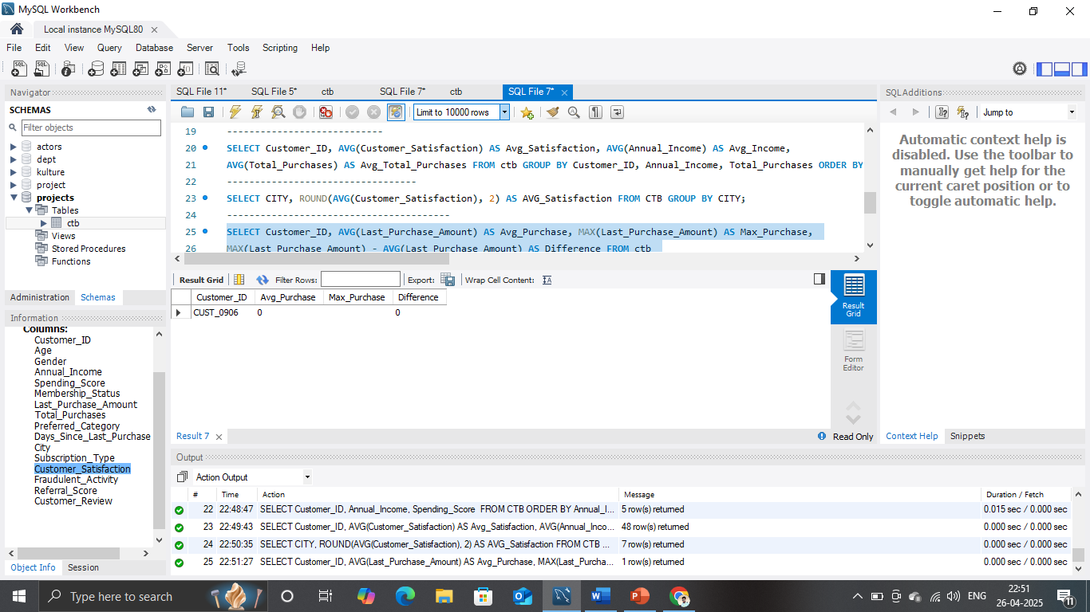
High Purchase Customers Analysis
Query/Task: Find customers where the max purchase is 3 times greater than their average purchase.
SQL Answer:
sql
SELECT Customer_ID, AVG(Last_Purchase_Amount) AS Avg_Purchase,
MAX(Last_Purchase_Amount) AS Max_Purchase,
MAX(Last_Purchase_Amount) - AVG(Last_Purchase_Amount) AS Difference FROM ctb
GROUP BY Customer_ID
HAVING Max_Purchase >= 3 * AVG(Last_Purchase_Amount) ORDER BY Difference DESC;

Slide 14
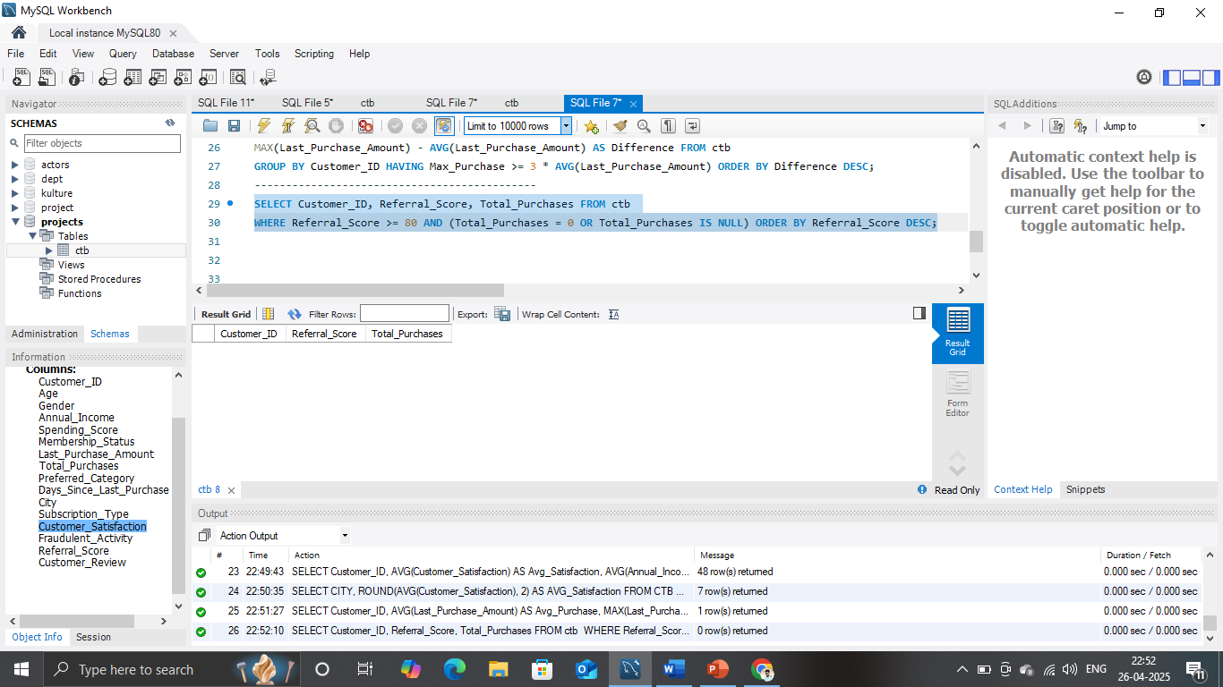
High Referral Score but Low Purchases
Query/Task: Find customers who have high referral scores but no or zero purchases.
SQL Answer:
SELECT Customer_ID, Referral_Score, Total_Purchases FROM ctb
WHERE Referral_Score >= 80 AND (Total_Purchases = 0 OR Total_Purchases IS NULL)
ORDER BY Referral_Score DESC;

Slide 15
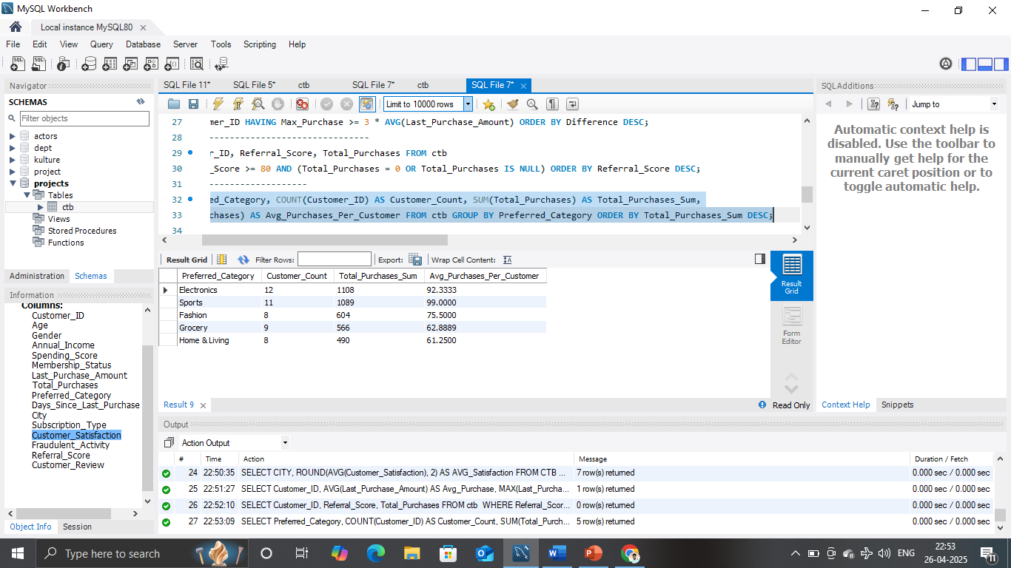
Preferred Category Analysis
Query/Task: Analyze customer count and total purchases by preferred category.
SQL Answer:
SELECT Preferred_Category, COUNT(Customer_ID) AS Customer_Count,
SUM(Total_Purchases) AS Total_Purchases_Sum,
AVG(Total_Purchases) AS Avg_Purchases_Per_Customer
FROM ctb GROUP BY Preferred_Category ORDER BY Total_Purchases_Sum DESC;

Slide 16
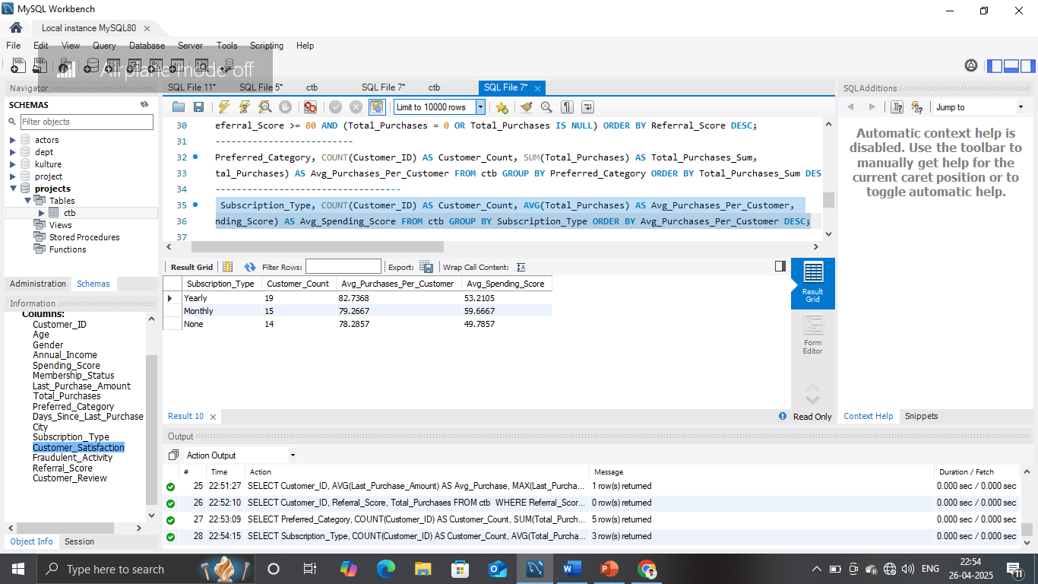
Subscription Type Analysis
Query/Task: Analyze customer behavior based on subscription type.
SQL Answer:
SELECT Subscription_Type, COUNT(Customer_ID) AS Customer_Count,
AVG(Total_Purchases) AS Avg_Purchases_Per_Customer,
AVG(Spending_Score) AS Avg_Spending_Score FROM ctb
GROUP BY Subscription_Type ORDER BY Avg_Purchases_Per_Customer DESC;

Slide 17
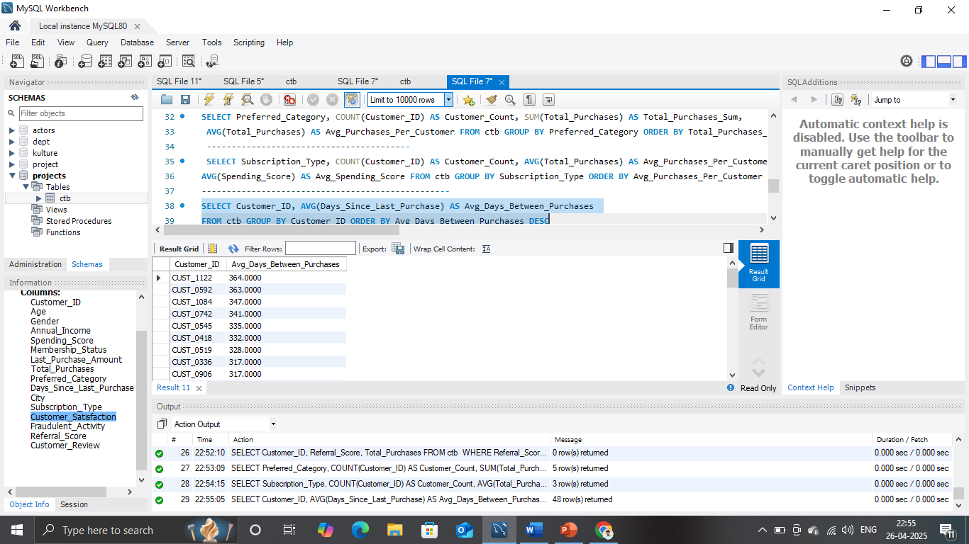
Customers with Highest Gaps Between Purchases
Query/Task: Find customers who take longer between purchases.
SQL Answer:
SELECT Customer_ID, AVG(Days_Since_Last_Purchase) AS Avg_Days_Between_Purchases
FROM ctb GROUP BY Customer_ID ORDER BY Avg_Days_Between_Purchases DESC;

Slide 18
Conclusion
Using SQL, we successfully analyzed the customer dataset from multiple perspectives like age group, membership status, subscription types, city, and referral scores.
We identified key customer segments with higher spending habits, high satisfaction, and loyalty opportunities.
Top customers and inactive customers were spotted based on purchase behavior, helping in future targeted marketing strategies.
Data quality checks were performed to ensure that insights are based on clean and reliable data by checking for NULL values and duplicates.
Overall, this analysis helps the business understand its customer base better and supports data-driven decision-making for improving customer engagement and profitability.

Slide 19
Key Takeaways:
Focus on high spenders and loyal customers to maximize revenue.
Design special offers for inactive or high-referral customers with no purchases.
Improve customer satisfaction in lower-performing cities or membership groups.
Maintain clean data practices for better future analysis.

